Slide 1
NETWORK ANALYSIS
USING ARCGIS

Slide 2
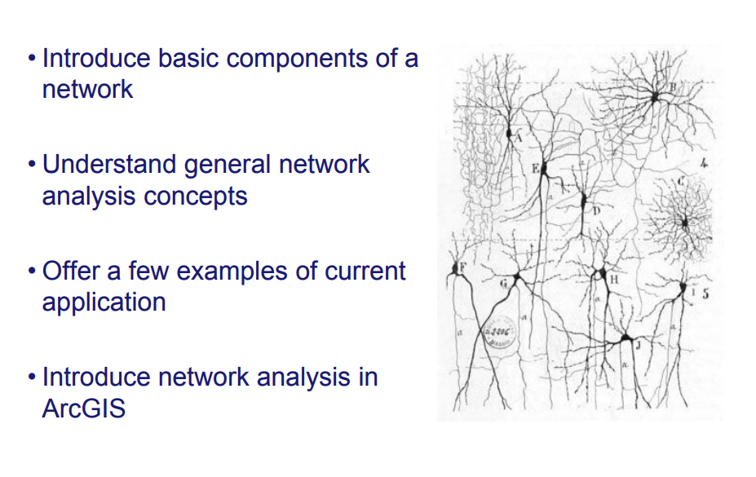

Slide 3
Network and its components

Slide 4
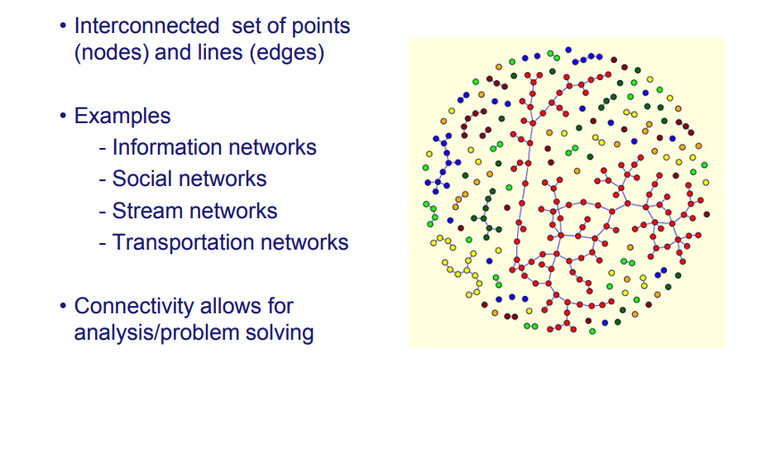
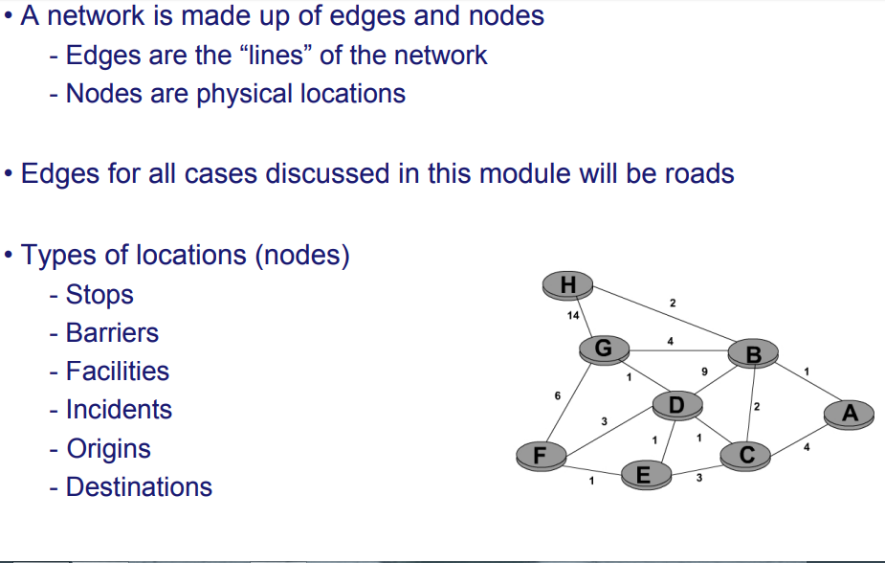

Slide 5
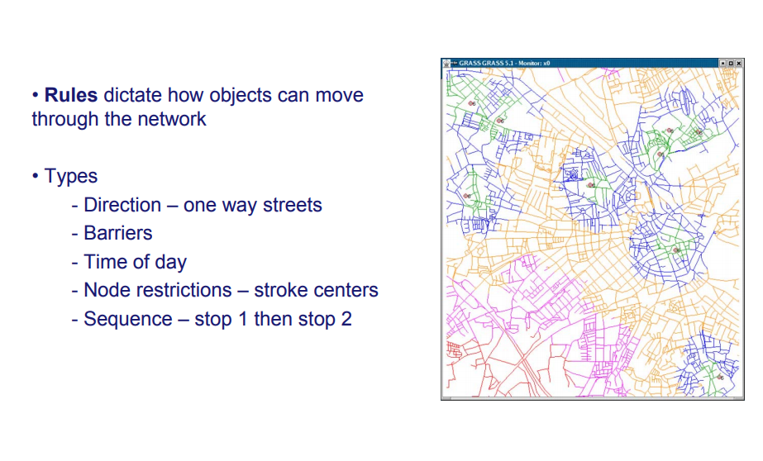

Slide 6
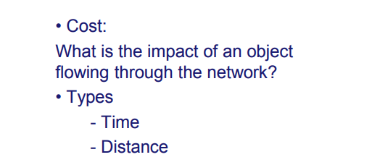

Slide 7
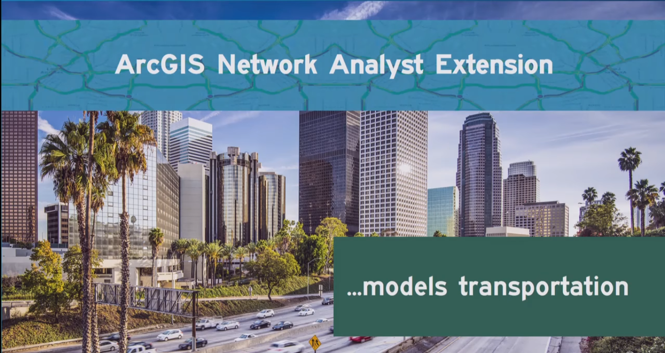
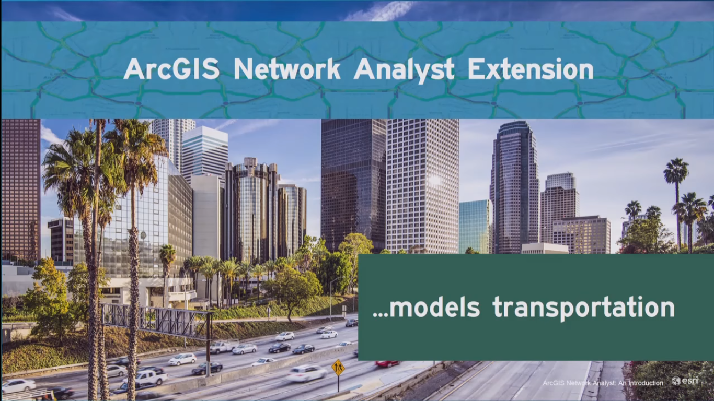

Slide 8
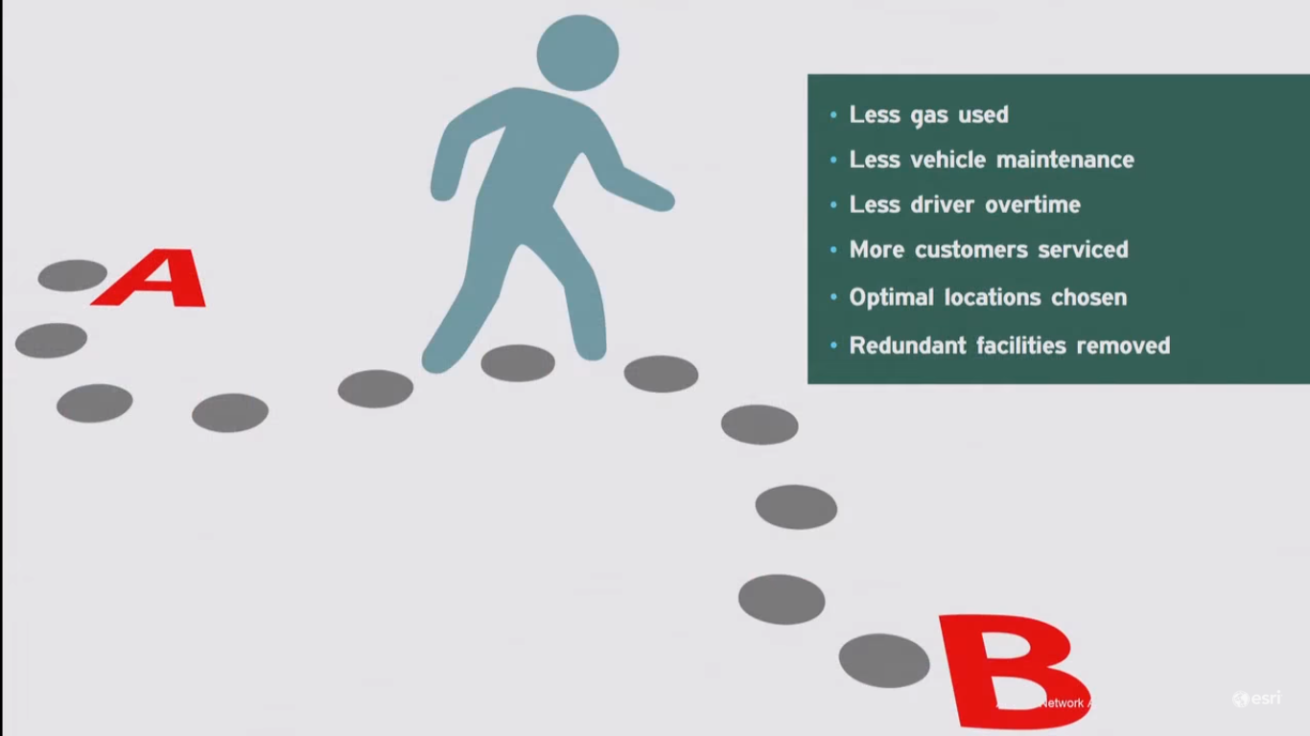

Slide 9



Slide 10
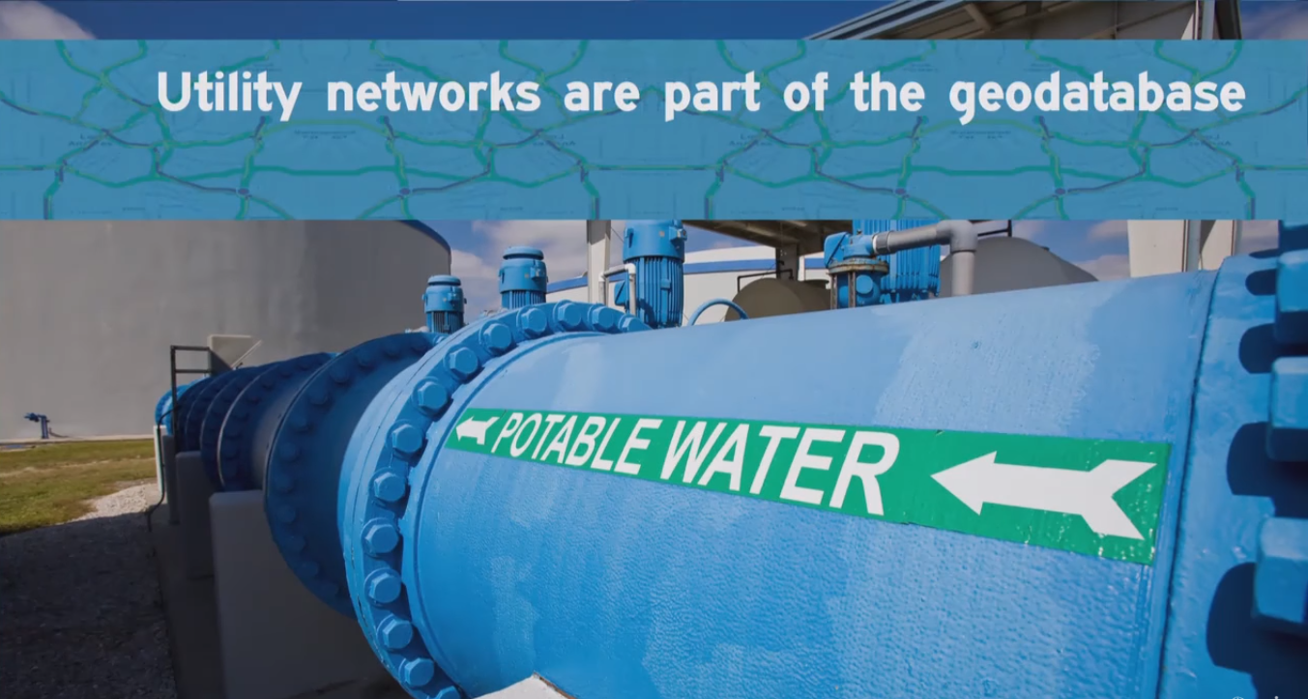
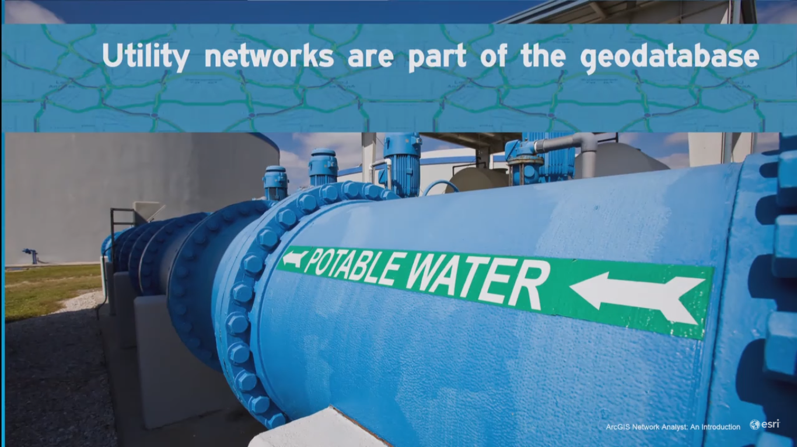

Slide 11
Restrictions
are inverse to smooth flow
They inhibit the flow of traffic
They increase travel time
They can’t be ignored

Slide 12
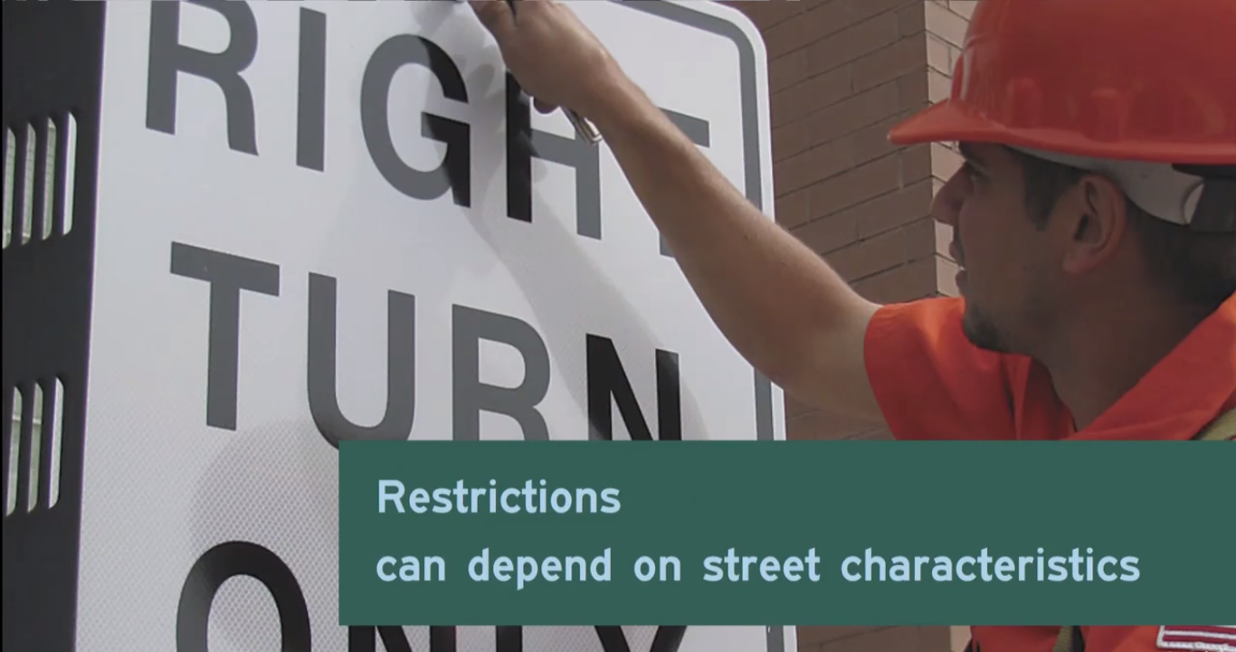
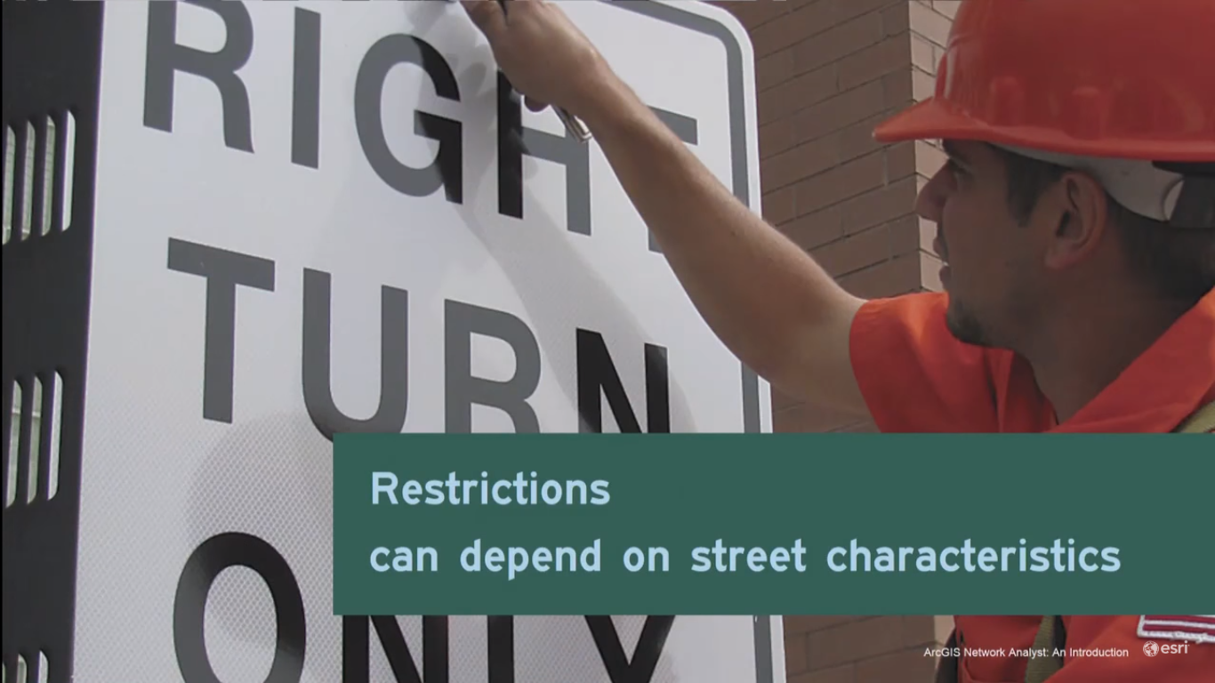

Slide 13
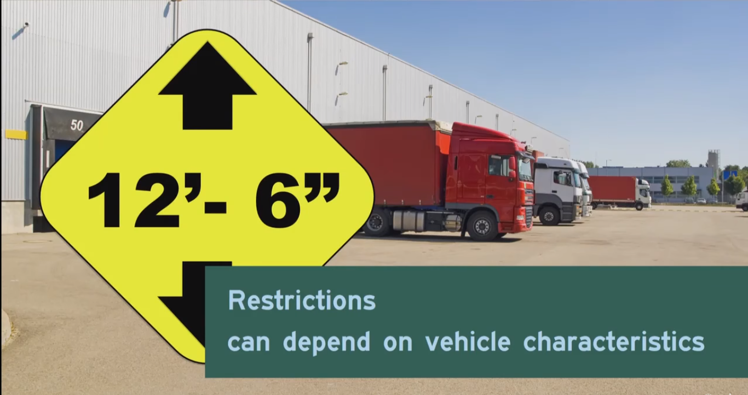

Slide 14


Slide 15
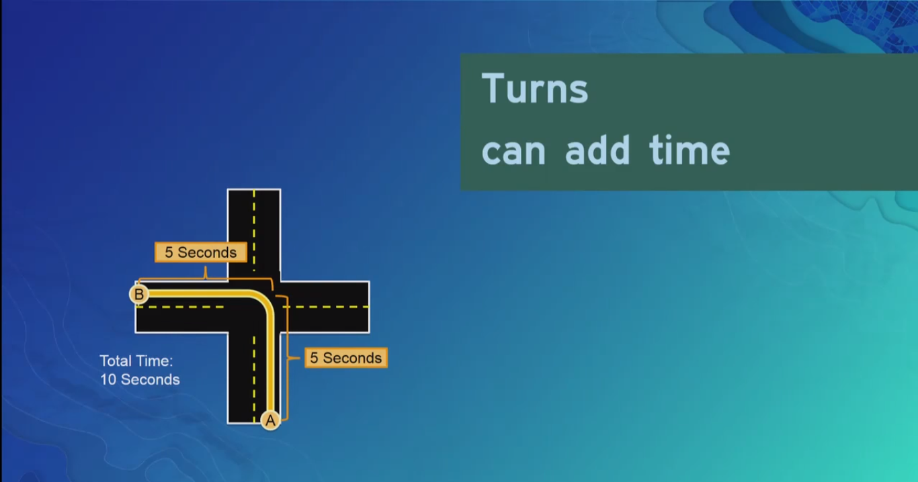

Slide 16
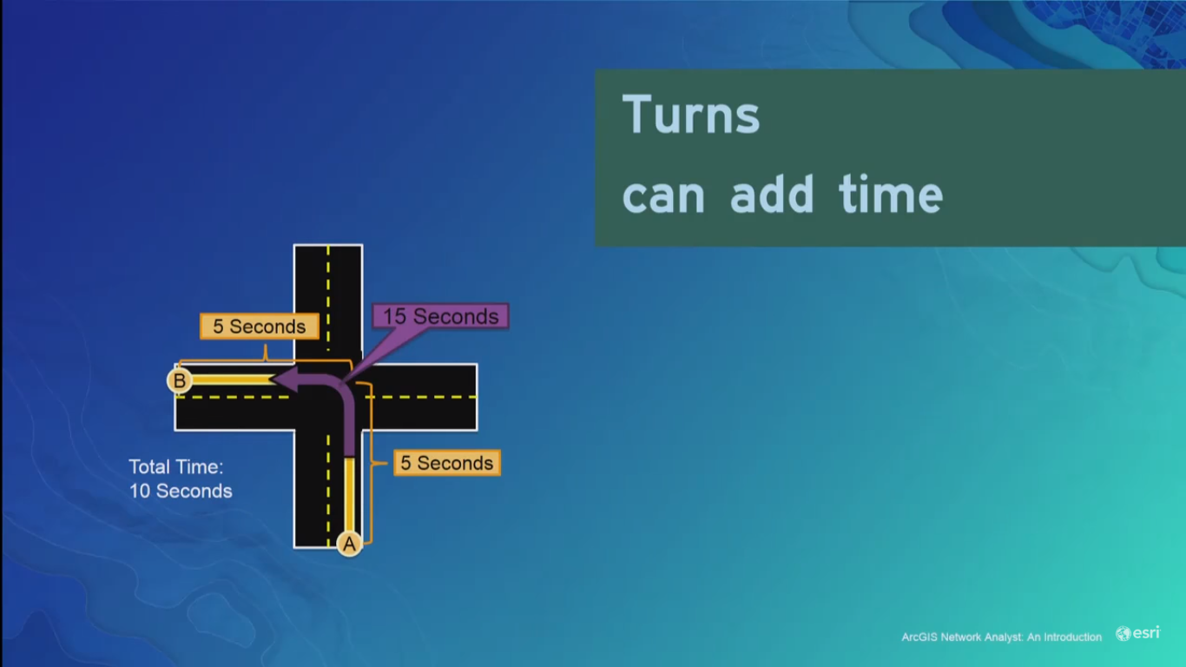

Slide 17
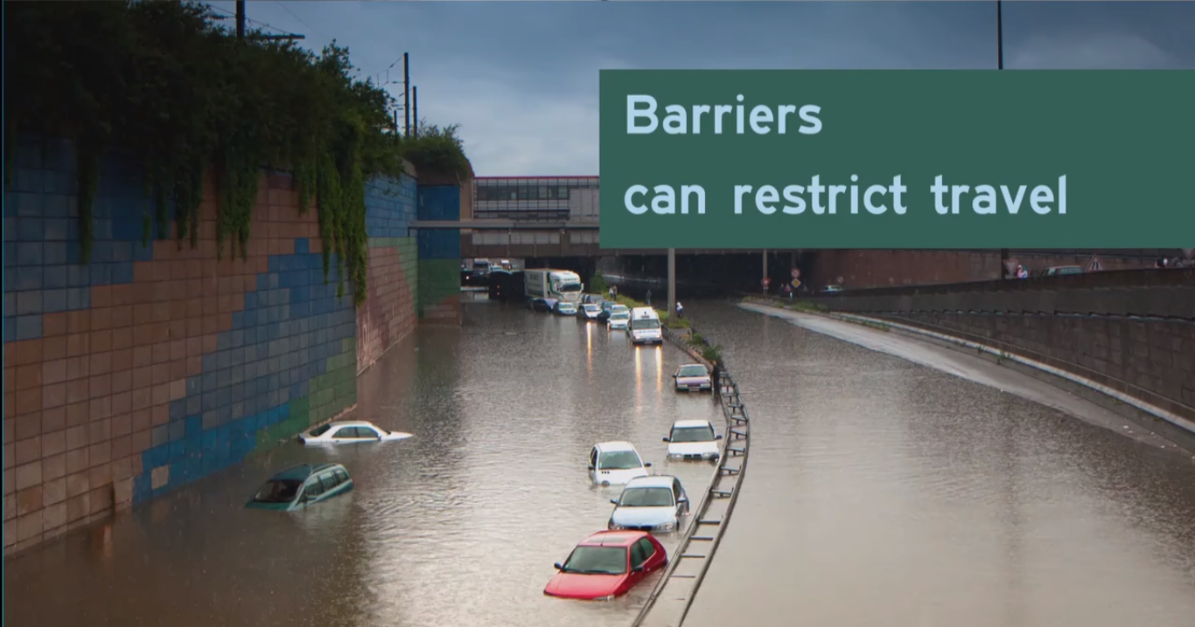

Slide 18
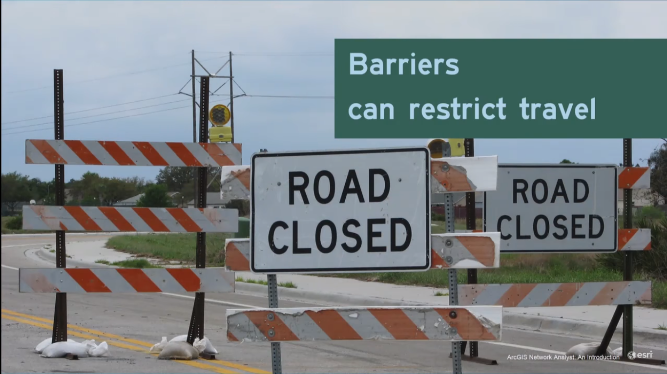

Slide 19
Network tests
New Route
Closest facility
New Service area
New OD matrix

Slide 20
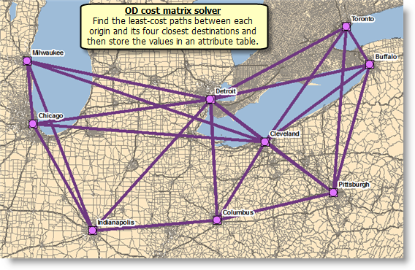
OD MATRIX

Slide 21
OD MATRIX
The OD cost matrix finds and measures the least-cost paths along the network from multiple origins to multiple destinations. When configuring an OD cost matrix analysis, you can specify the number of destinations to find and a maximum distance to search.
In the graphic below, the OD cost matrix found the least-cost paths from each origin to the four nearest destinations. The output shape type was set to produce straight lines.

Slide 22
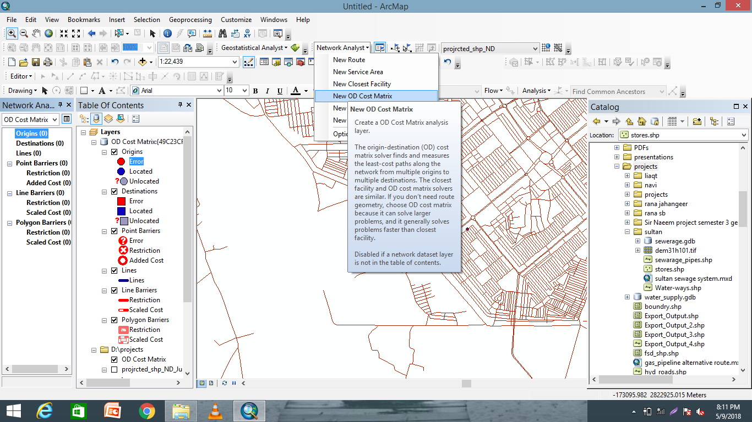
Big concept
Bring the attention of your audience over a key concept using icons or illustrations

Slide 23
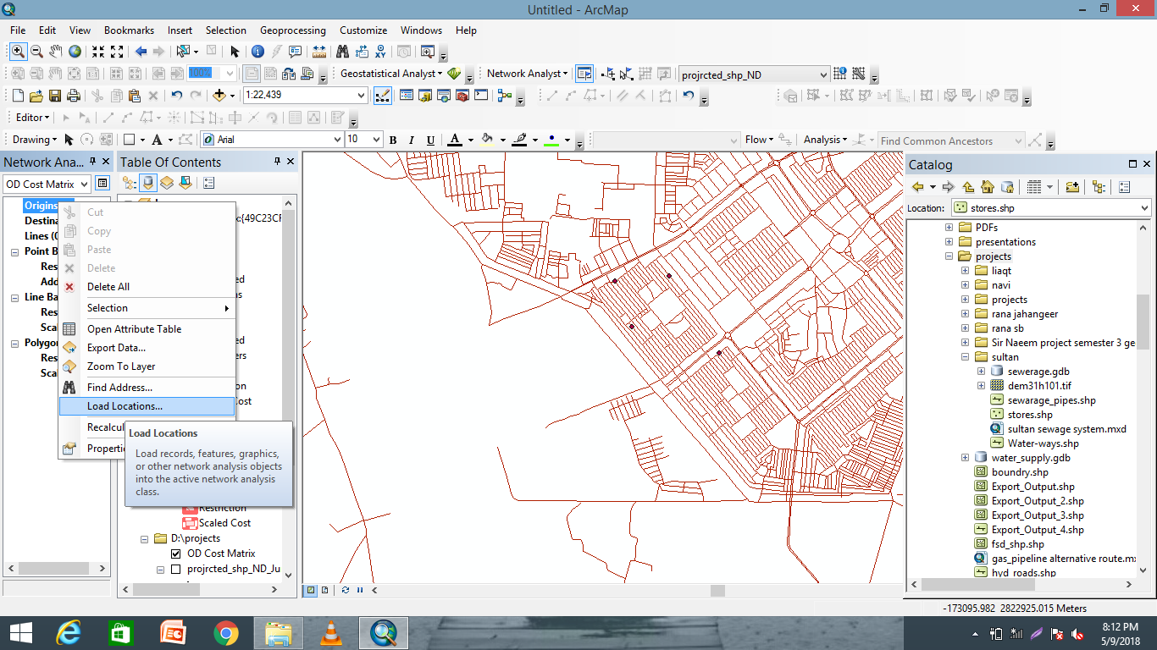
You can also split your content
White
Is the color of milk and fresh snow, the color produced by the combination of all the colors of the visible spectrum.
Black
Is the color of coal, ebony, and of outer space. It is the darkest color, the result of the absence of or complete absorption of light.

Slide 24
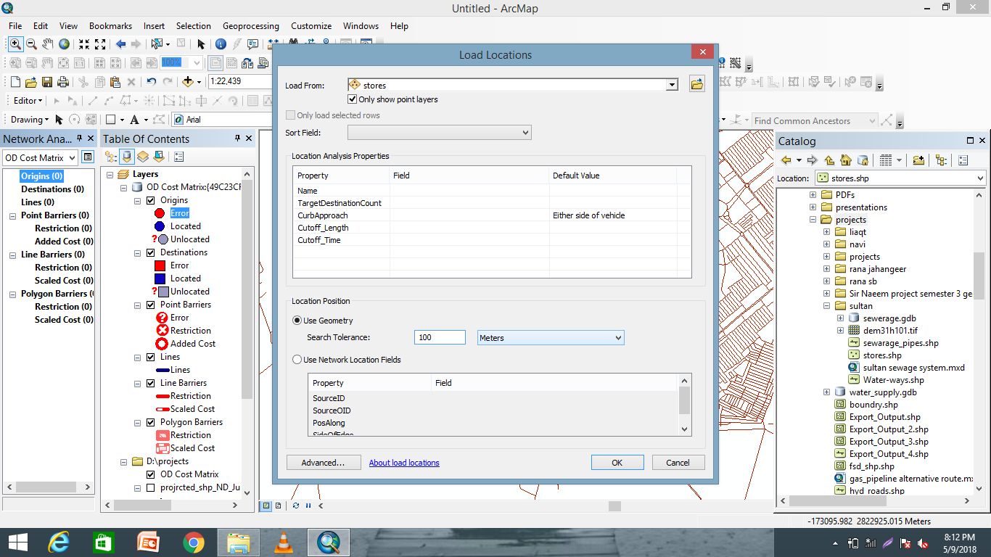
In two or three columns
Yellow
Is the color of gold, butter and ripe lemons. In the spectrum of visible light, yellow is found between green and orange.
Blue
Is the colour of the clear sky and the deep sea. It is located between violet and green on the optical spectrum.
Red
Is the color of blood, and because of this it has historically been associated with sacrifice, danger and courage.

Slide 25
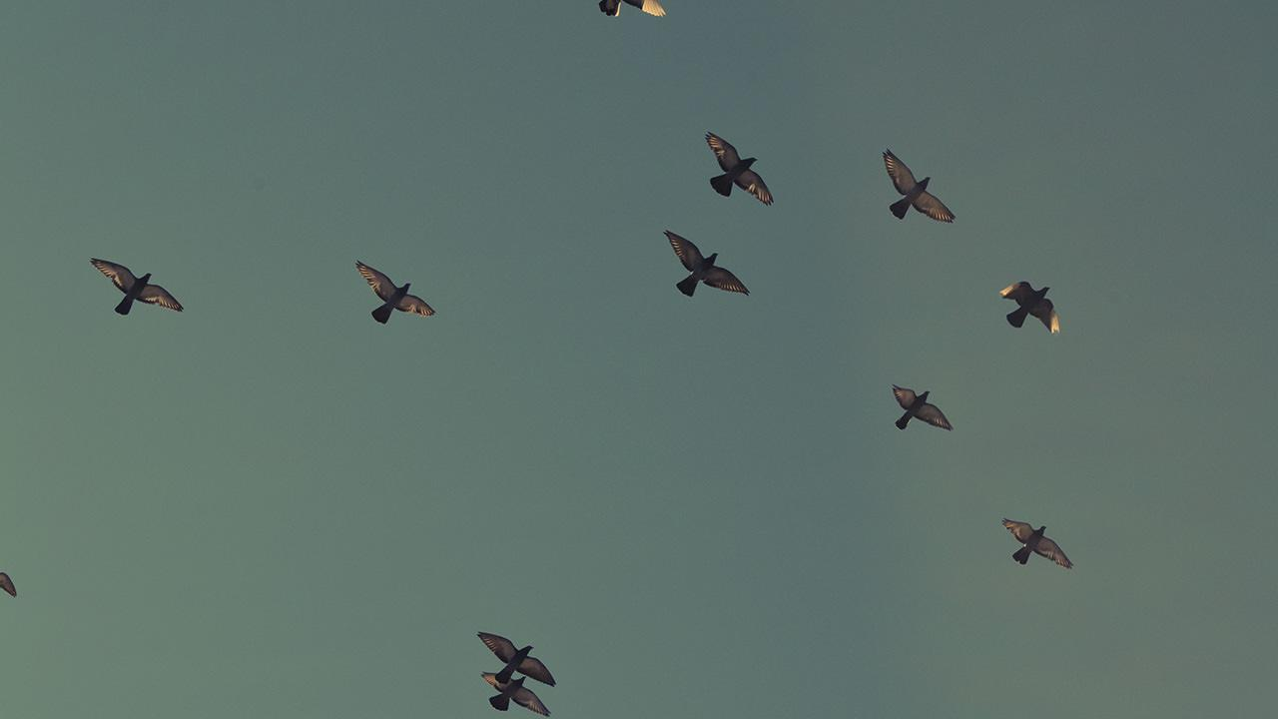
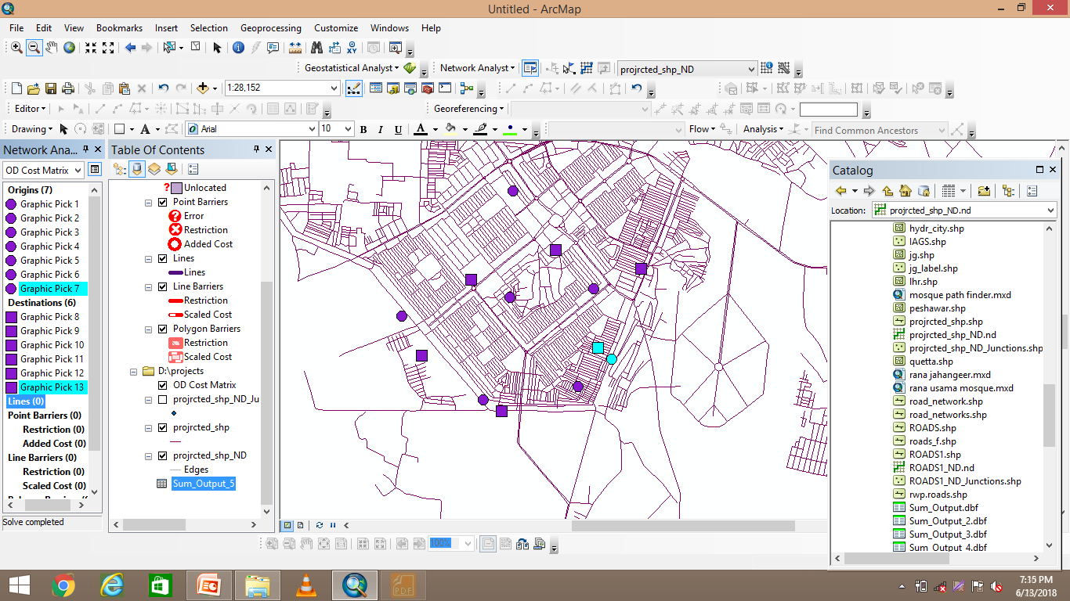
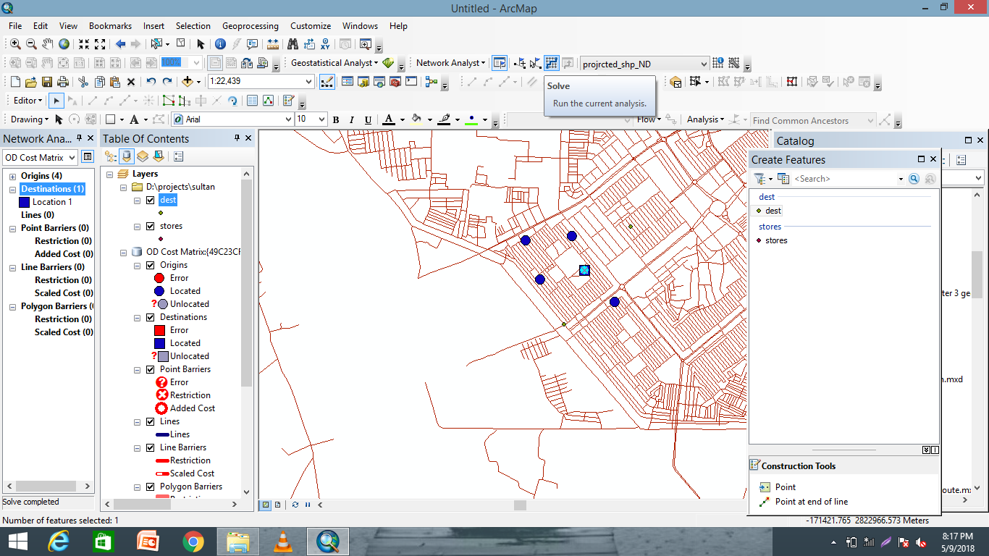
A picture is worth a thousand words
A complex idea can be conveyed with just a single still image, namely making it possible to absorb large amounts of data quickly.

Slide 26
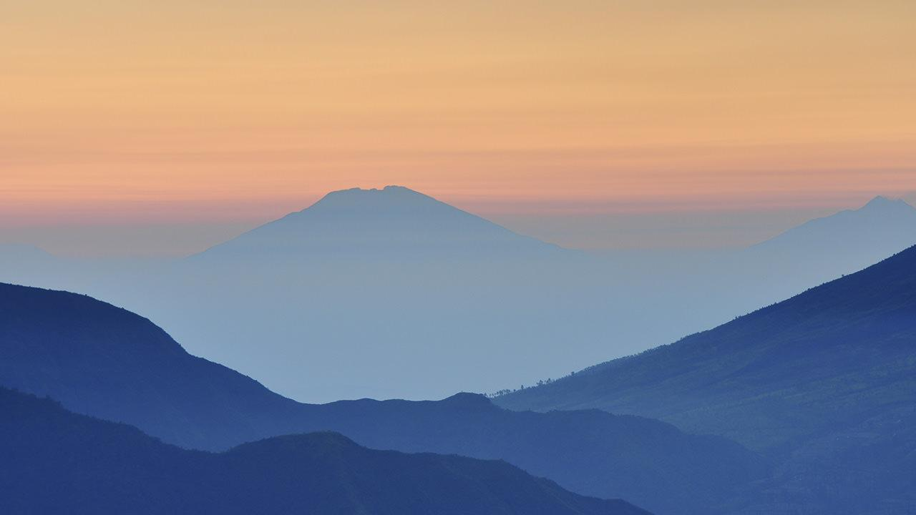
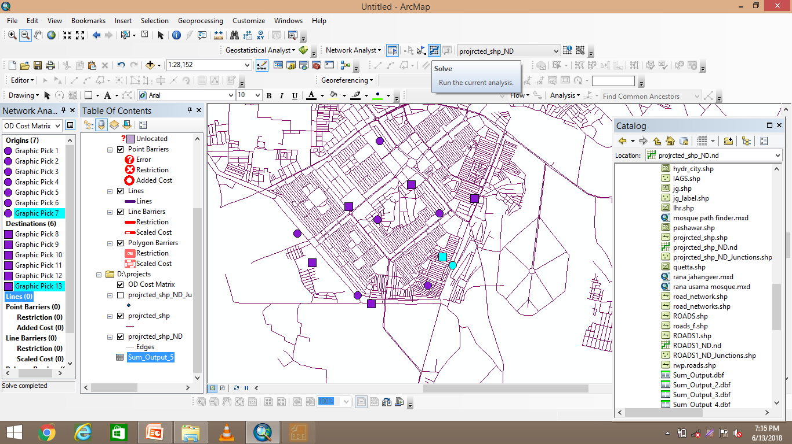
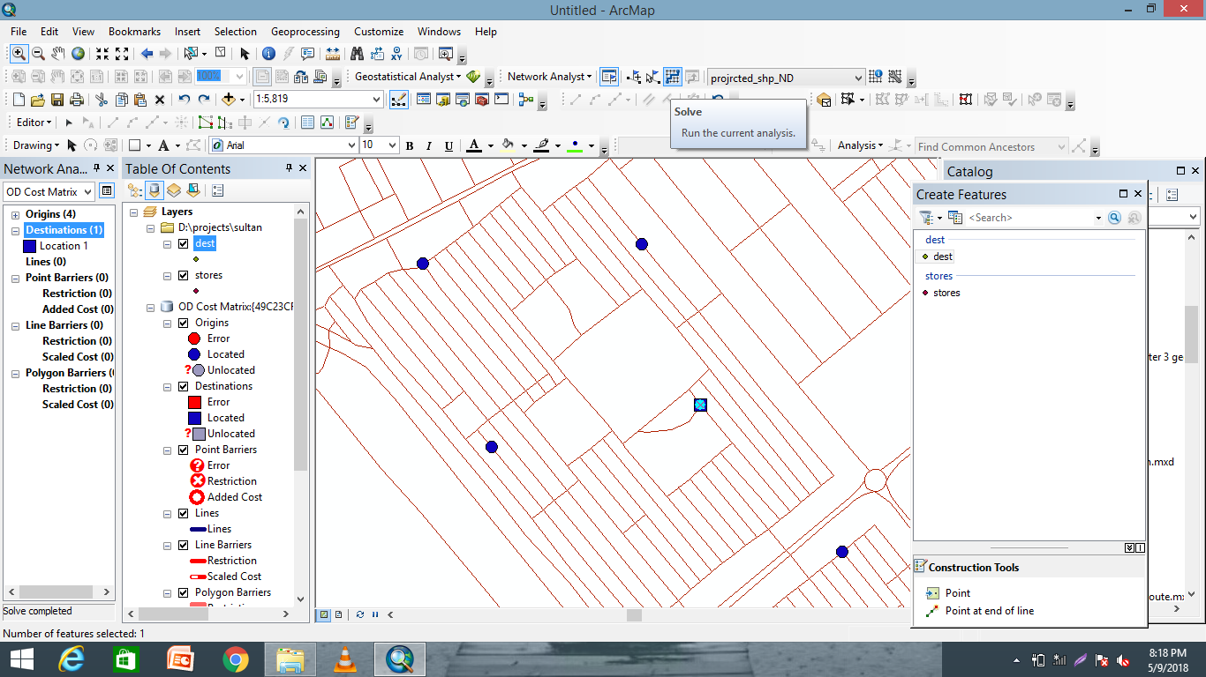
Want big impact?
Use big image.

Slide 27
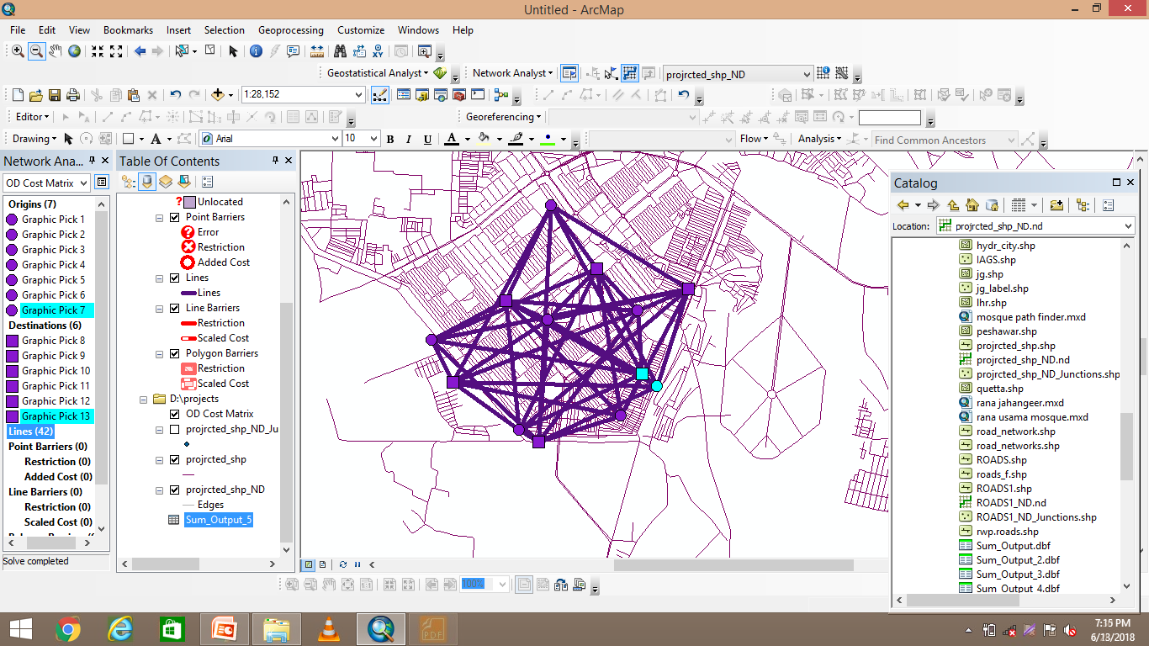
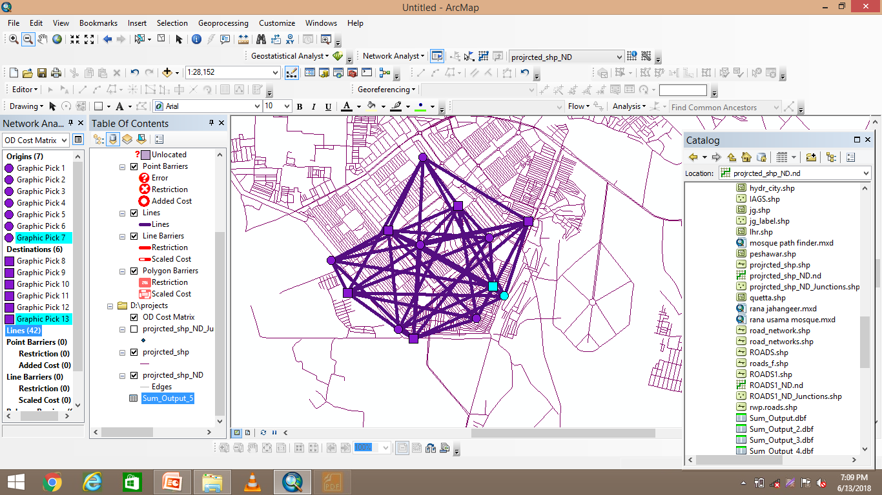
Use charts to explain your ideas
White
Gray
Black

Slide 28
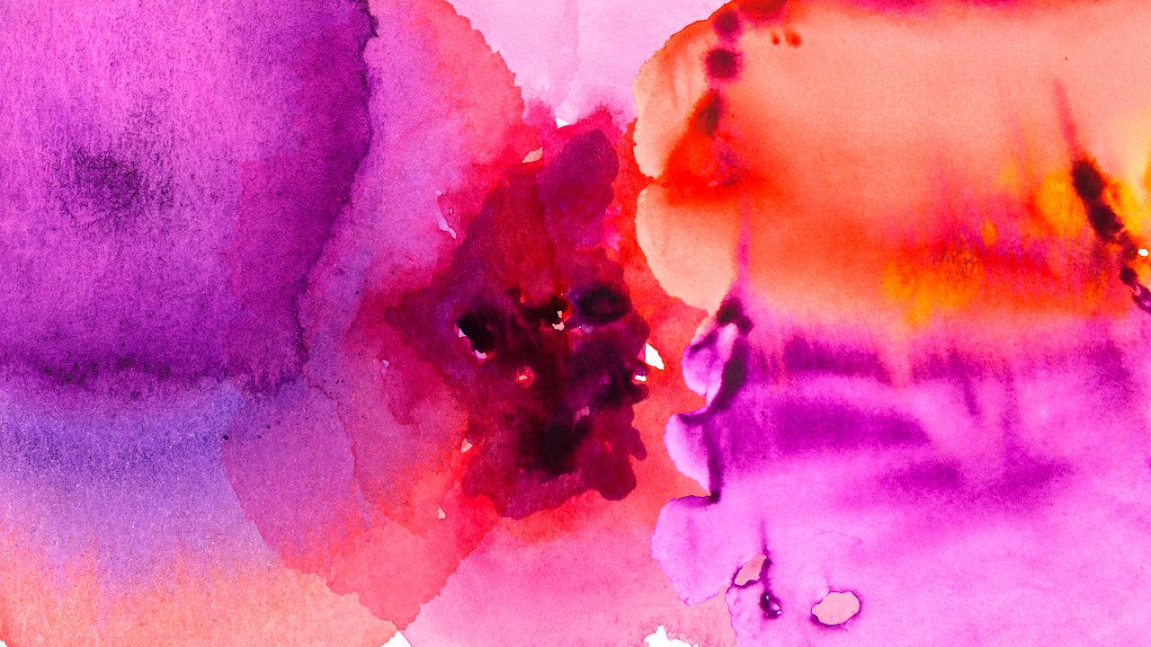
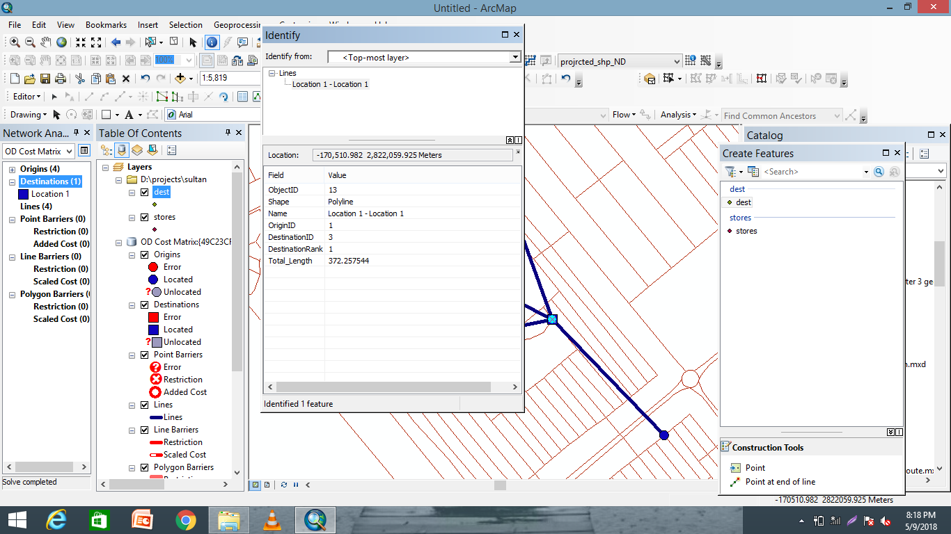
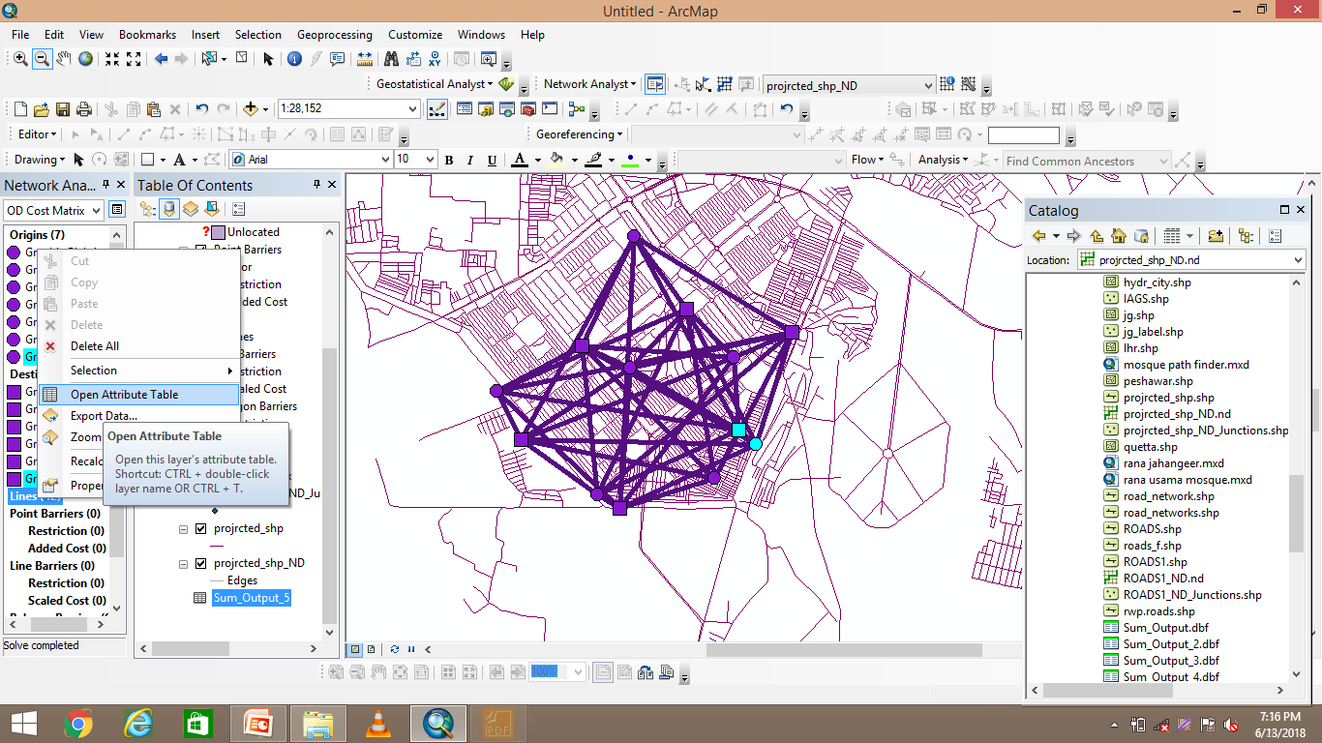
And tables to compare data
 | A | B | C
Yellow | 10 | 20 | 7
Blue | 30 | 15 | 10
Orange | 5 | 24 | 16

Slide 29
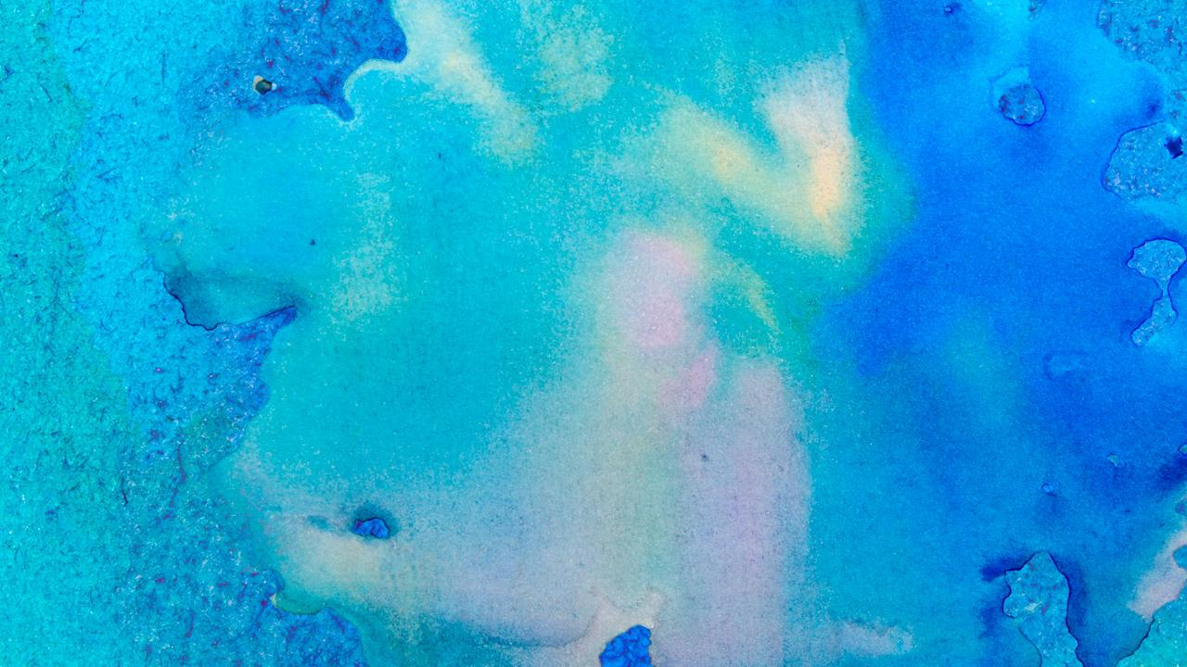
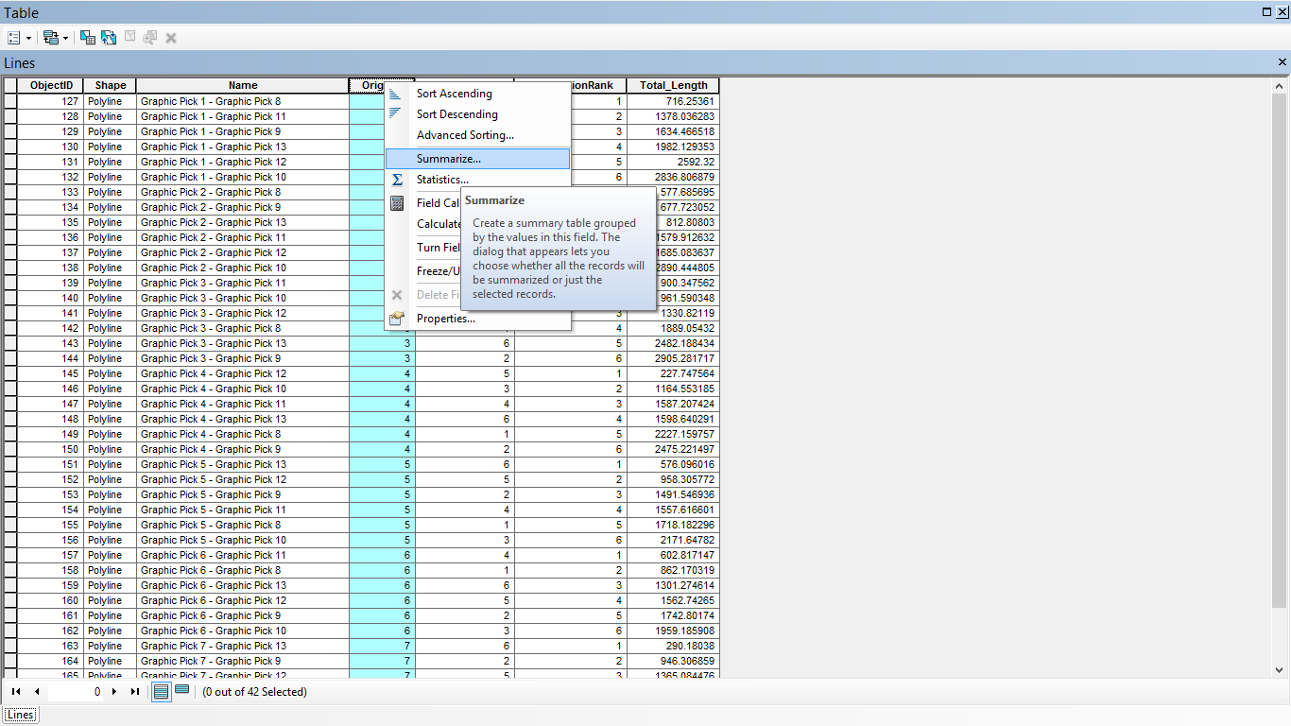
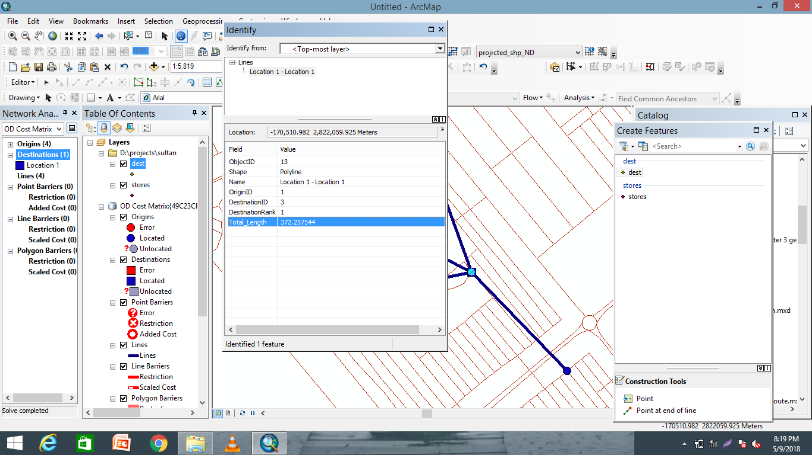
Maps
our office

Slide 30
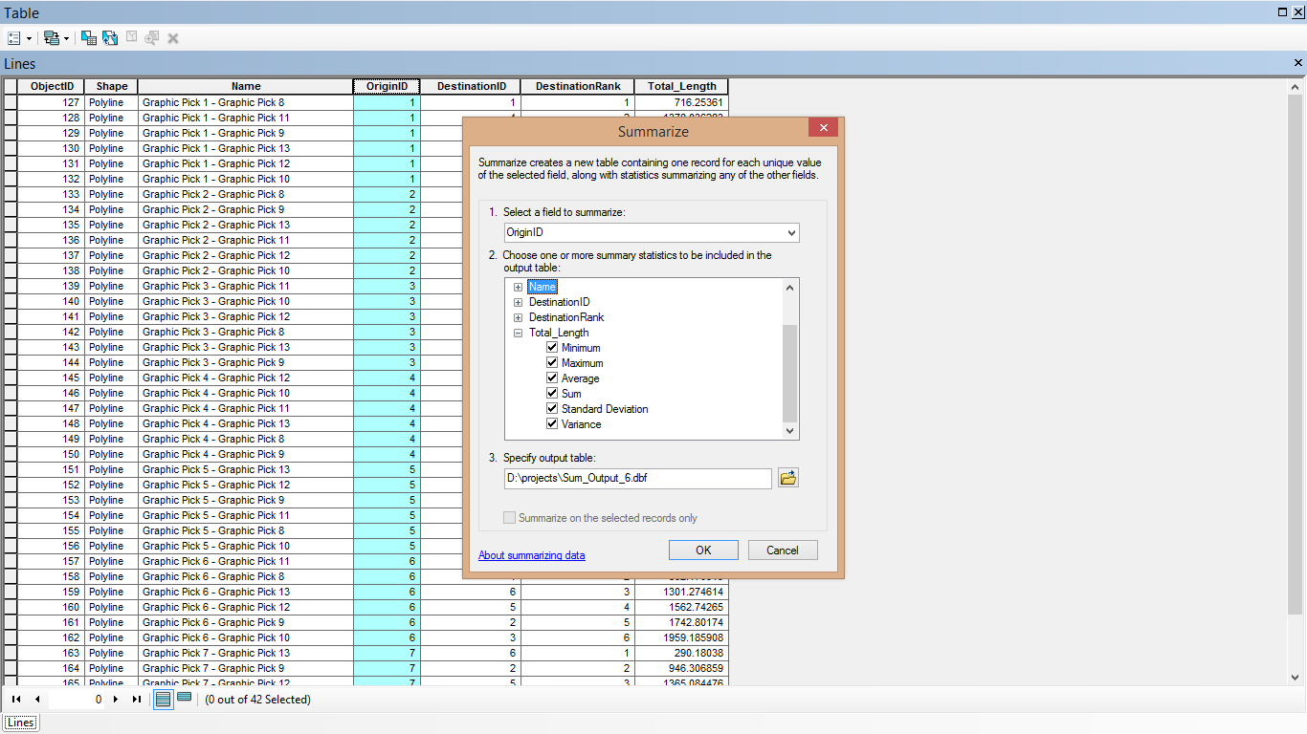
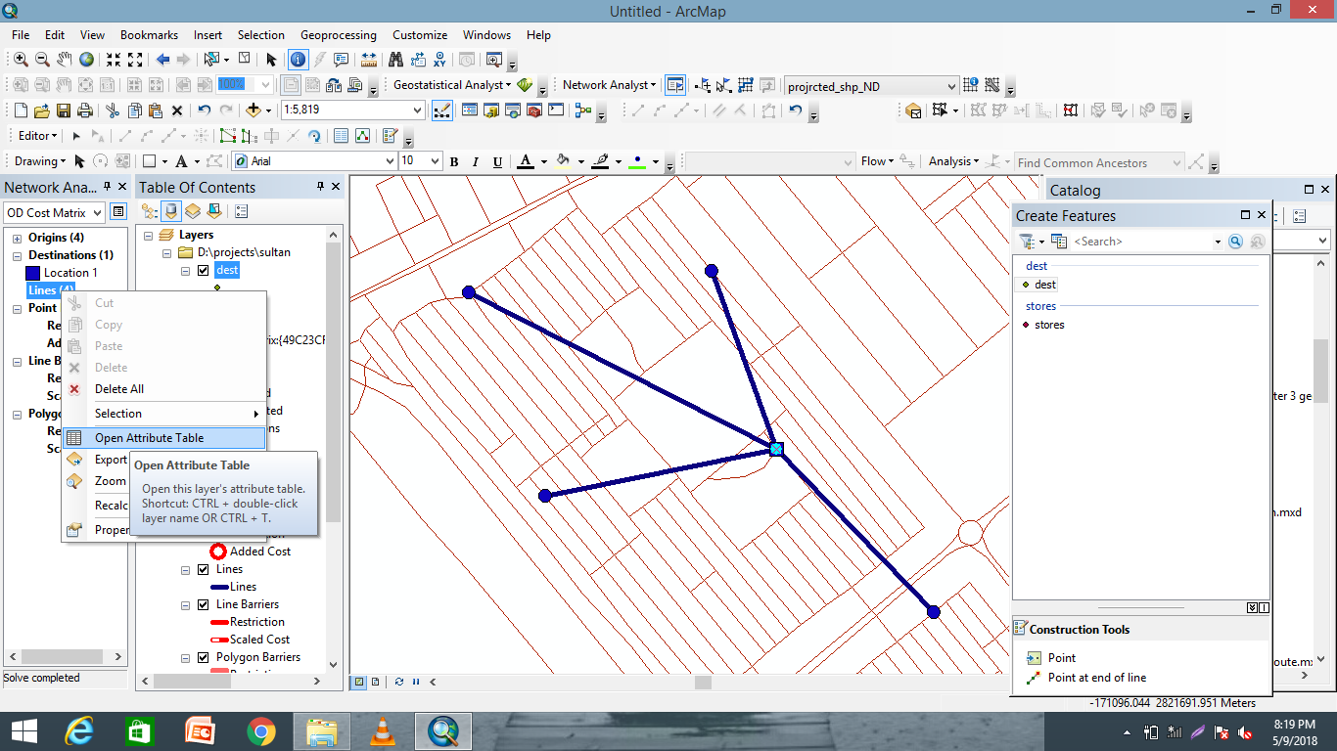
89,526,124
Whoa! That’s a big number, aren’t you proud?

Slide 31
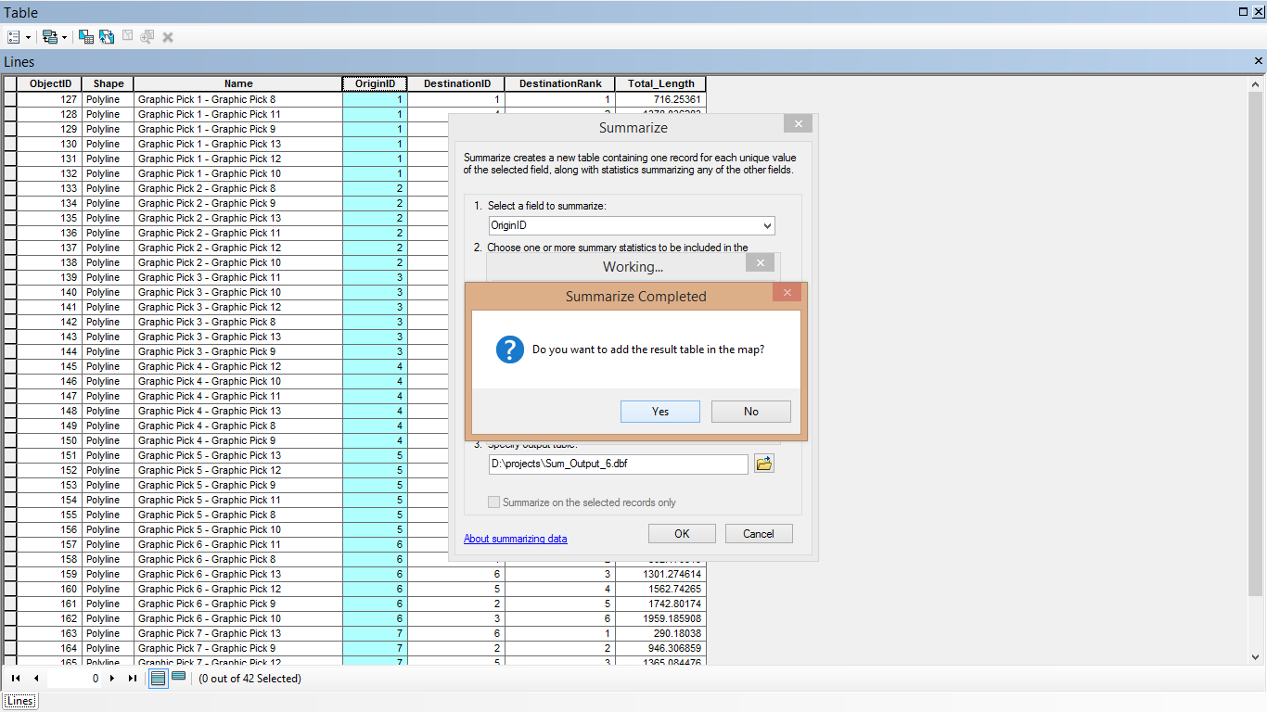
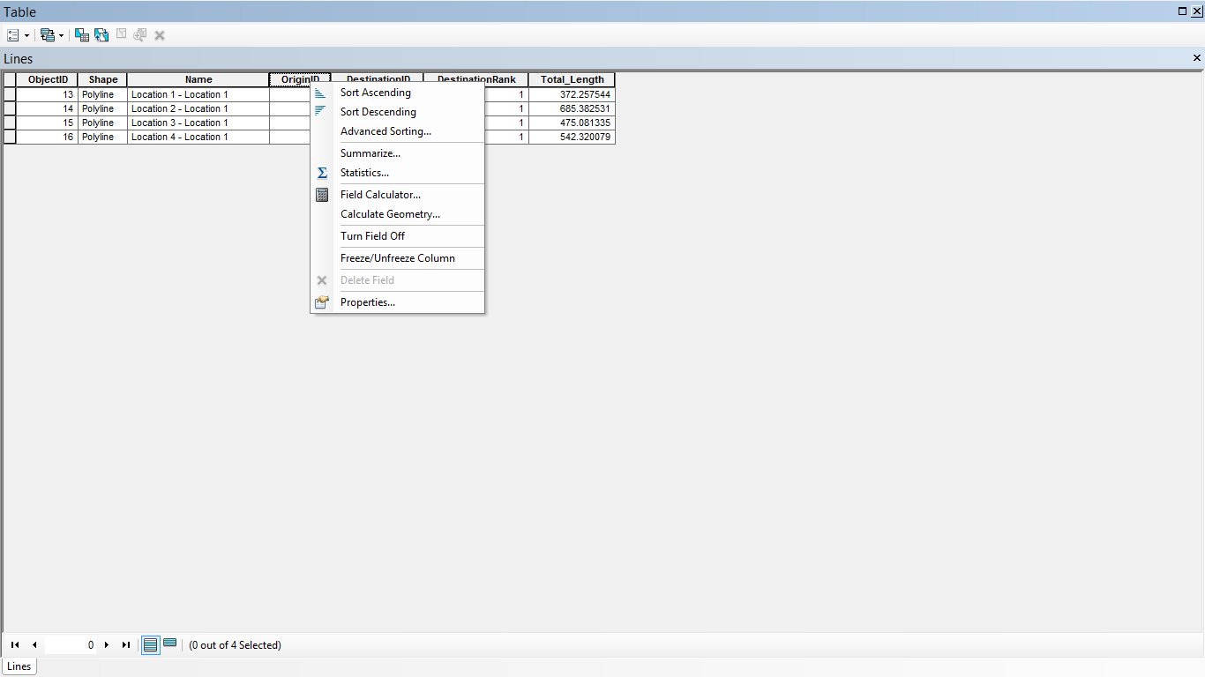
89,526,124$
185,244 users
100%
That’s a lot of money
And a lot of users
Total success!

Slide 32
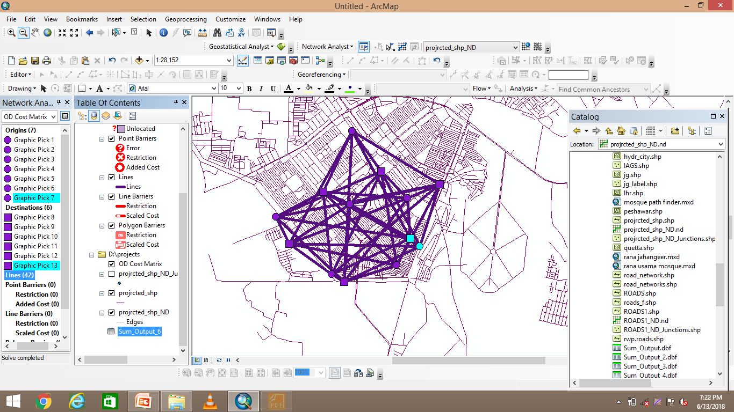
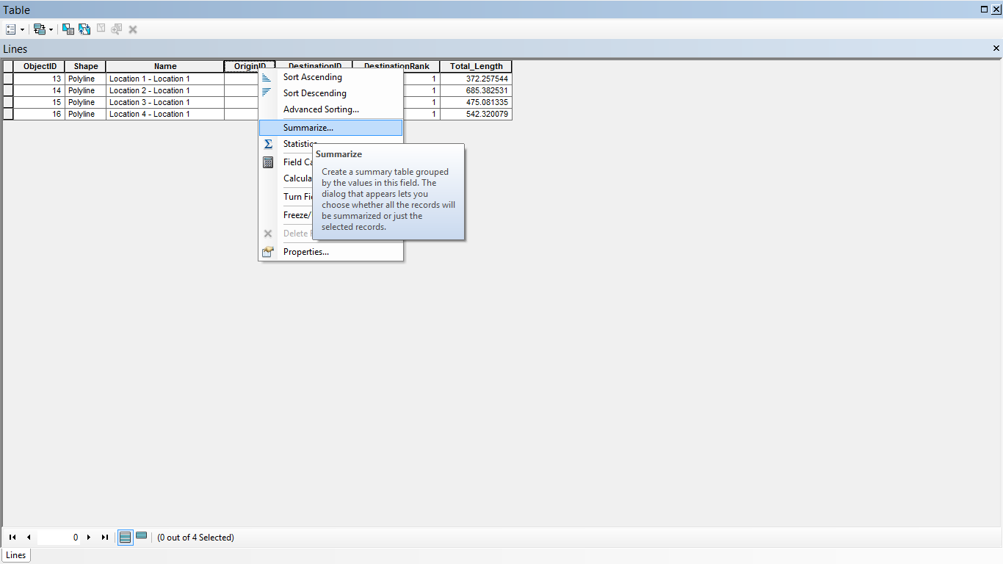
Our process is easy
first
second
last

Slide 33
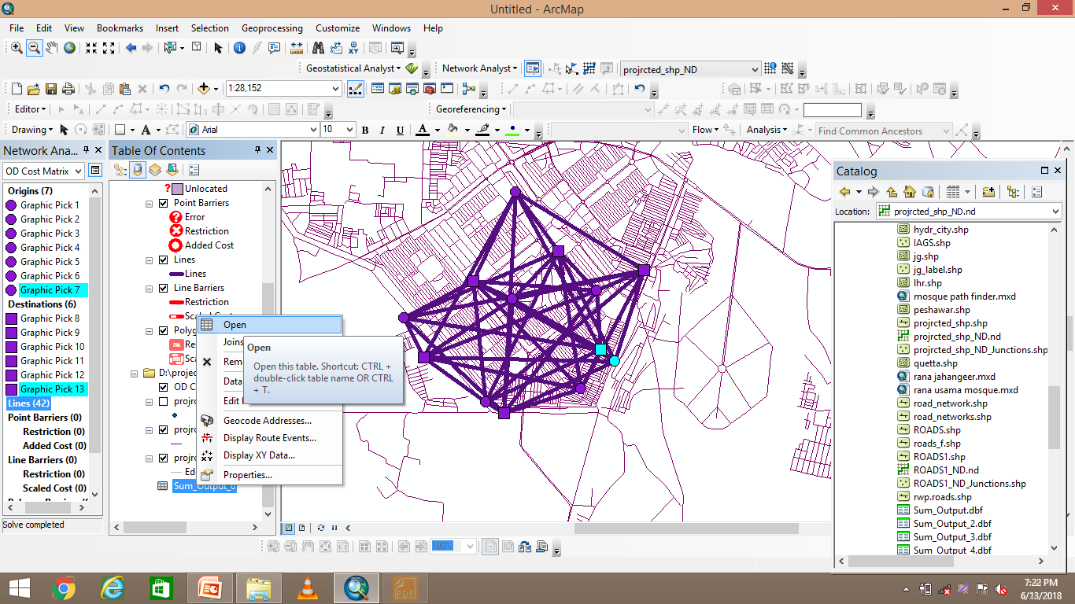
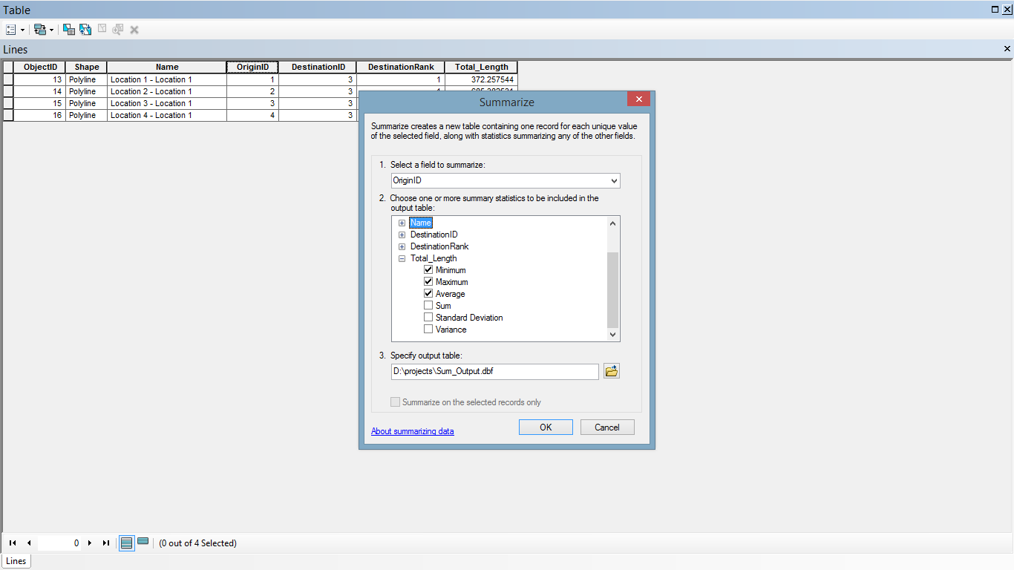
Let’s review some concepts
Yellow
Is the color of gold, butter and ripe lemons. In the spectrum of visible light, yellow is found between green and orange.
Blue
Is the colour of the clear sky and the deep sea. It is located between violet and green on the optical spectrum.
Red
Is the color of blood, and because of this it has historically been associated with sacrifice, danger and courage.
Yellow
Is the color of gold, butter and ripe lemons. In the spectrum of visible light, yellow is found between green and orange.
Blue
Is the colour of the clear sky and the deep sea. It is located between violet and green on the optical spectrum.
Red
Is the color of blood, and because of this it has historically been associated with sacrifice, danger and courage.

Slide 34
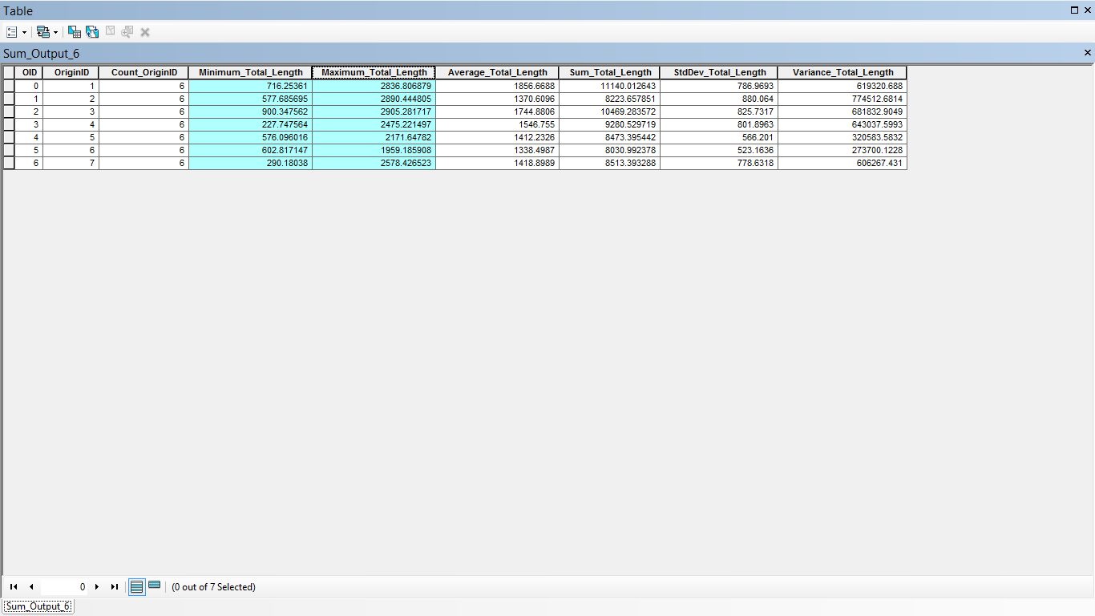


Slide 35
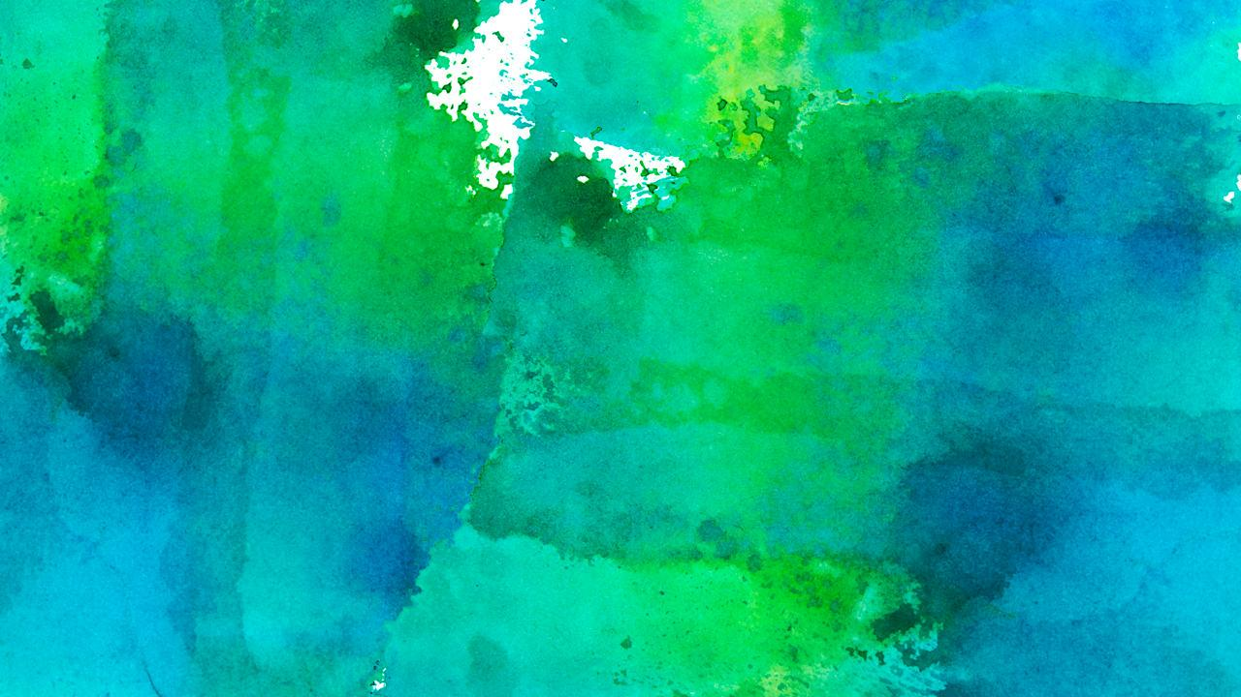
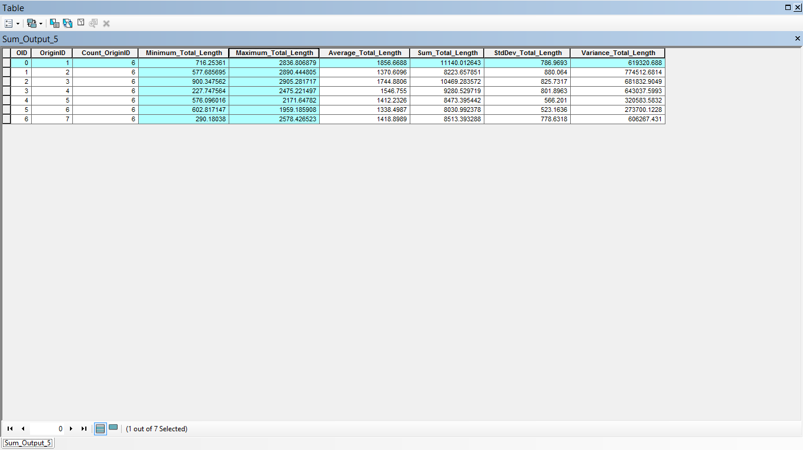
Tablet project
Show and explain your web, app or software projects using these gadget templates.
Place your screenshot here

Slide 36
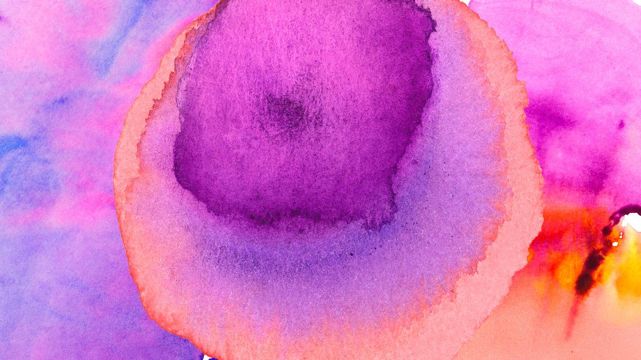
Service area
A network service area is a region that encompasses all accessible streets (that is, streets that are within a specified impedance). For instance, the 5-minute service area for a point includes all the streets that can be reached within five minutes from that point. Service areas created by Network Analyst also help evaluate accessibility. Concentric service areas show how accessibility varies with impedance. Once built, you can use service areas to identify how many people, how much land, or the quantity of anything else that is within the neighborhood.

Slide 37
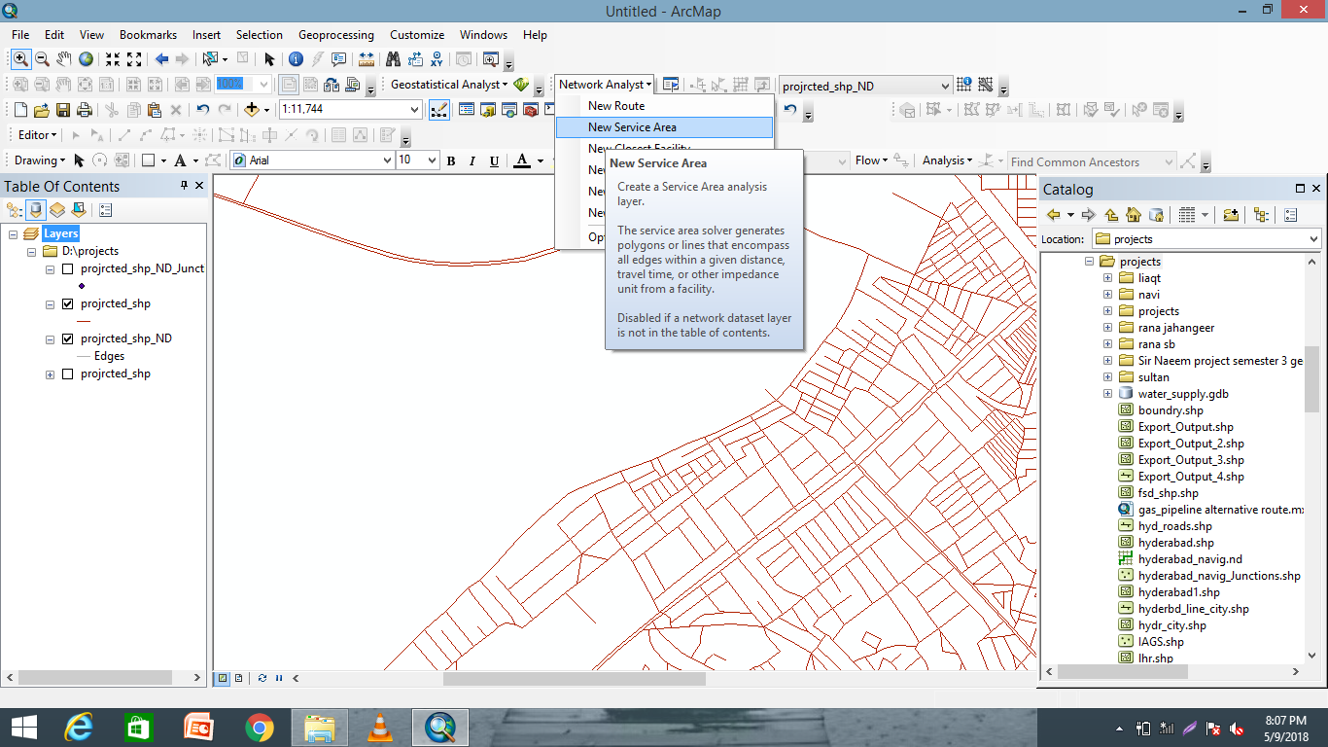
Special thanks to all the people who made and released these awesome resources for free:
Presentation template by SlidesCarnival
Photographs by Unsplash
Watercolor textures by GraphicBurguer

Slide 38
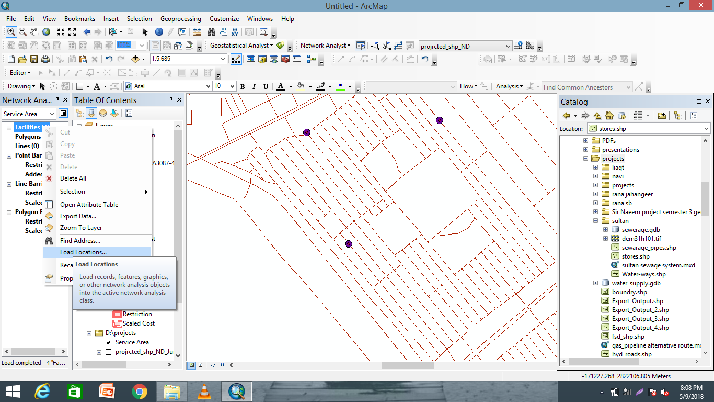
Presentation design
This presentation uses the following typographies and colors:
Titles: Lato Thin
Body copy: Lato Light
You can download the fonts on this page:
http://www.latofonts.com/lato-free-fonts/
You don’t need to keep this slide in your presentation. It’s only here to serve you as a design guide if you need to create new slides or download the fonts to edit the presentation in PowerPoint®

Slide 39
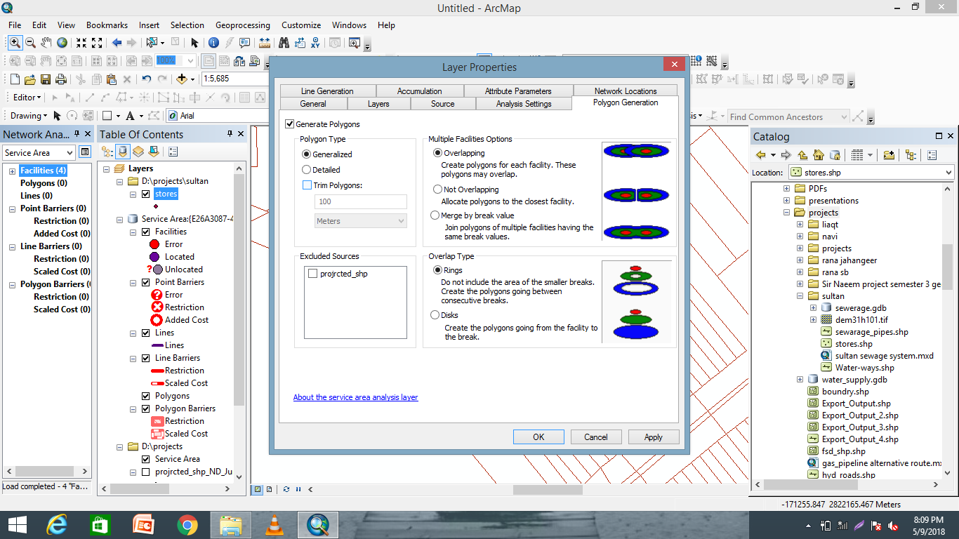
SlidesCarnival icons are editable shapes.
This means that you can:
Resize them without losing quality.
Change fill color and opacity.
Isn’t that nice? :)
Examples:

Slide 40


😉
Now you can use any emoji as an icon!
And of course it resizes without losing quality and you can change the color.
How? Follow Google instructions https://twitter.com/googledocs/status/730087240156643328
✋👆👉👍👤👦👧👨👩👪💃🏃💑❤😂😉😋😒😭👶😸🐟🍒🍔💣📌📖🔨🎃🎈🎨🏈🏰🌏🔌🔑 and many more...

Slide 41

😉
Now you can use any emoji as an icon!
And of course it resizes without losing quality and you can change the color.
How? Follow Google instructions https://twitter.com/googledocs/status/730087240156643328
✋👆👉👍👤👦👧👨👩👪💃🏃💑❤😂😉😋😒😭👶😸🐟🍒🍔💣📌📖🔨🎃🎈🎨🏈🏰🌏🔌🔑 and many more...

Slide 42

😉
Now you can use any emoji as an icon!
And of course it resizes without losing quality and you can change the color.
How? Follow Google instructions https://twitter.com/googledocs/status/730087240156643328
✋👆👉👍👤👦👧👨👩👪💃🏃💑❤😂😉😋😒😭👶😸🐟🍒🍔💣📌📖🔨🎃🎈🎨🏈🏰🌏🔌🔑 and many more...

Slide 43
new Route

Slide 44

😉
Now you can use any emoji as an icon!
And of course it resizes without losing quality and you can change the color.
How? Follow Google instructions https://twitter.com/googledocs/status/730087240156643328
✋👆👉👍👤👦👧👨👩👪💃🏃💑❤😂😉😋😒😭👶😸🐟🍒🍔💣📌📖🔨🎃🎈🎨🏈🏰🌏🔌🔑 and many more...

Slide 45


Slide 46


Slide 47


Slide 48


Slide 49


Slide 50


Slide 51


Slide 52


Slide 53


Slide 54


Slide 55


Slide 56


Slide 57


Slide 58
Thanks for bearing me

